Slide 1

MADAN MOHAN MALAVIYA UNIVERSITY OF TECHNOLOGY
GORAKHPUR
BID OUT – ONLINE AUCTION SYSTEM
Presented by:
YOGESH KUMAR PANDEY
Roll no.: 2024073074
M.C.A. 2nd Year (3rd Sem)
Under Supervision By:
MS. PRANJAL MAURYA
ASSISTANT PROFESSOR
DEPT. of ITCA

Slide 2
Contents
Abstract
Problem Statement
Objectives
Workflow
Future Work
References

Slide 3
Abstract
This project is a full-stack online bidding application allowing users to buy and sell items through auctions.
It includes authentication, auction creation, bidding, admin panel, and automated auction closing using cron jobs.

Slide 4
Problem Statement
Traditional offline auctions lack accessibility, transparency, and efficiency. There is a need for a digital system that automates the auctioning process.

Slide 5
Objectives
Build a platform for online auctions
Enable users to act as buyers and sellers
Secure authentication and authorization
Automated auction expiration
Admin dashboard

Slide 6
Workflow
User registers/logs in
Seller creates auction
Buyer places bids
Cron job closes expired auctions
Admin manages users

Slide 7
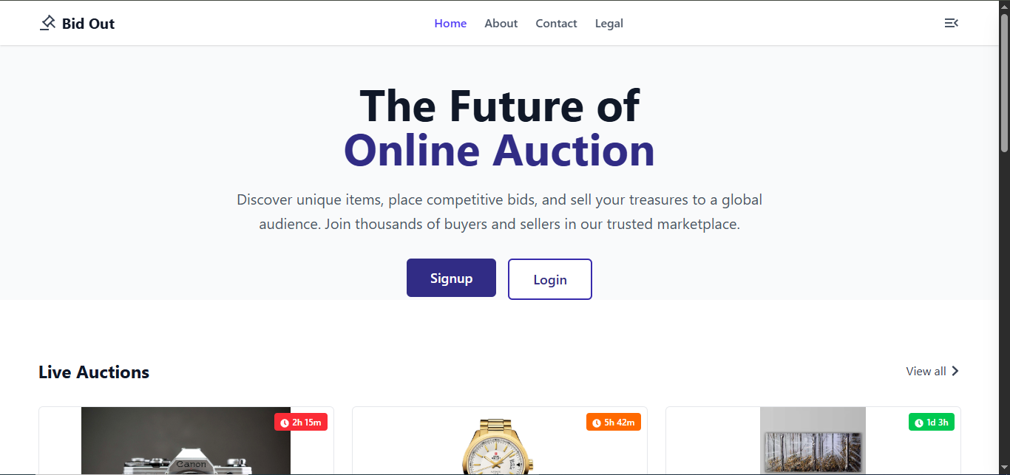
Screenshots

Slide 8
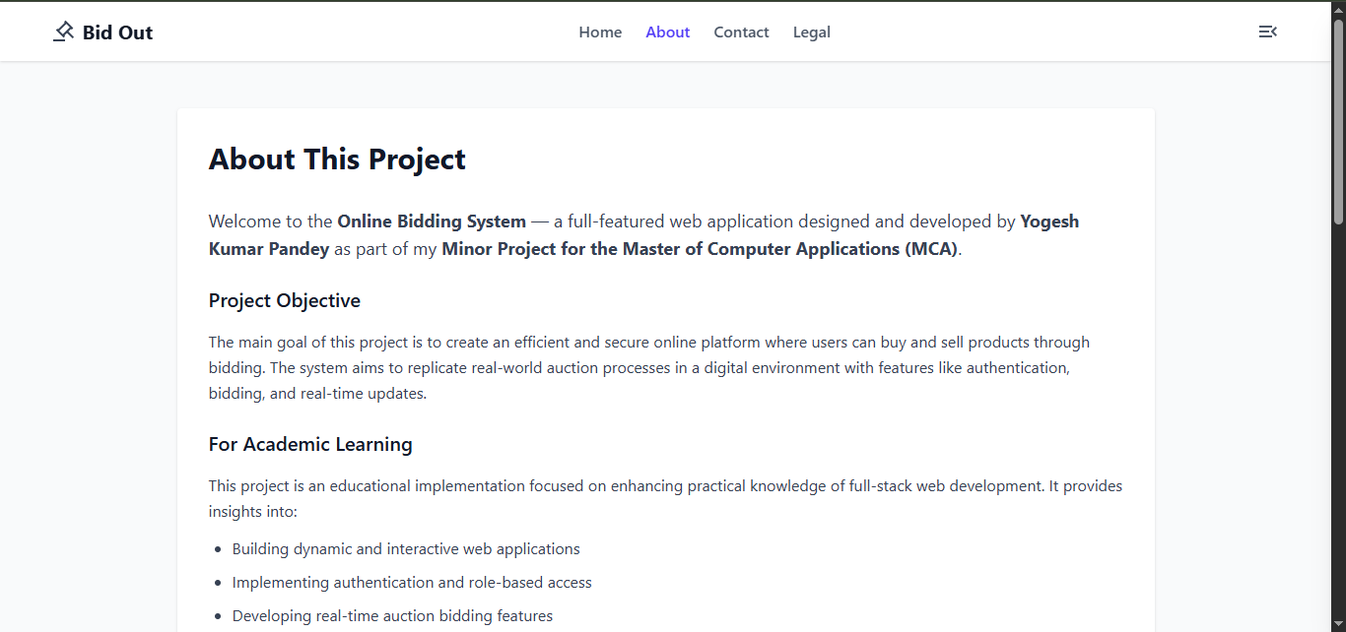
Screenshots

Slide 9
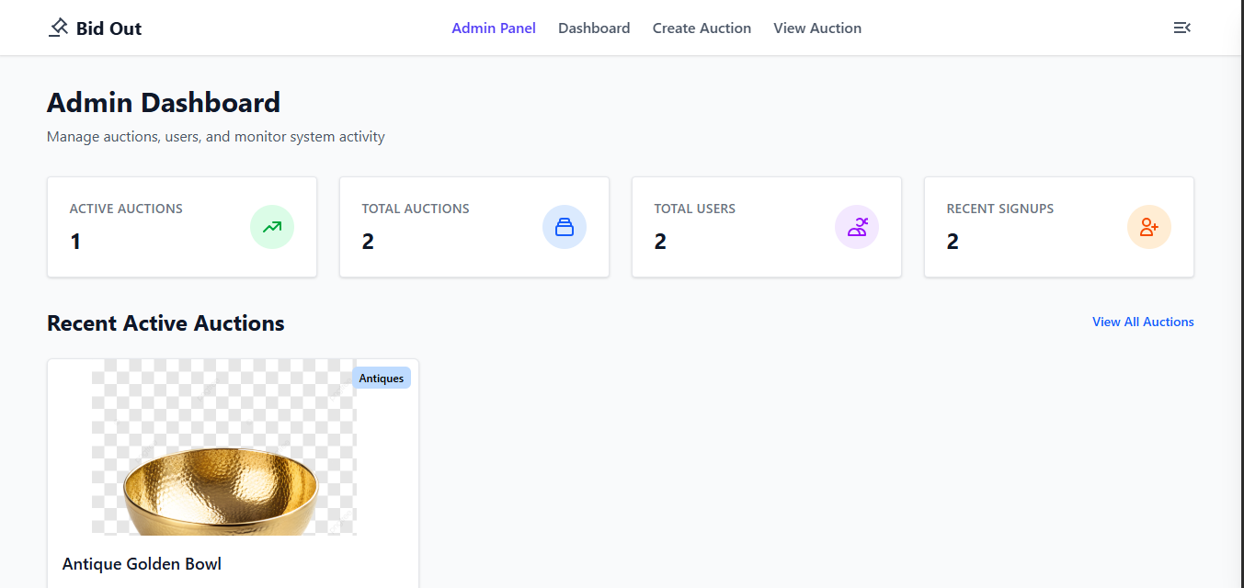
Screenshots

Slide 10
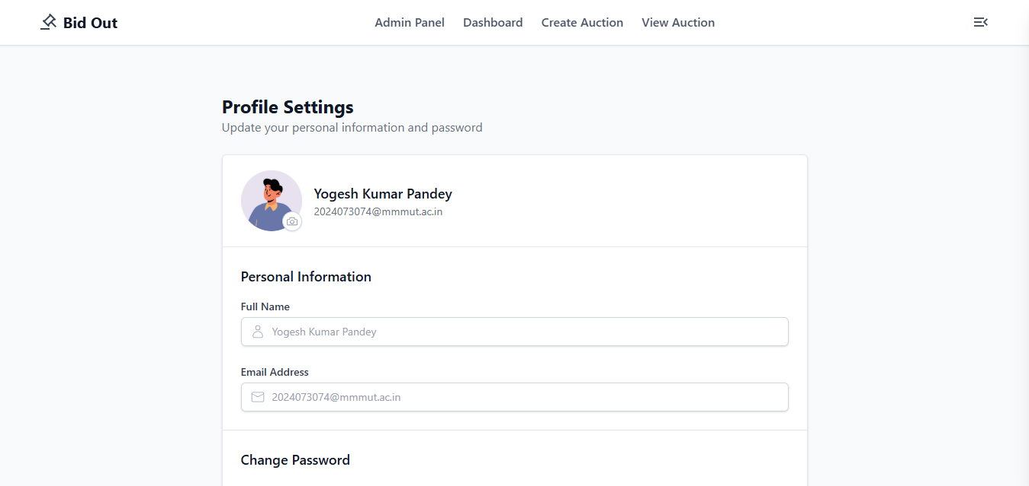
Screenshots

Slide 11
Future Work
Implement a user-friendly interface for easier interaction and analysis.
Expand the system to support multiple languages for broader applicability
.
Realtime bidding using WebSockets
Razorpay payment gateway
Mobile app version
AI-based price predictions
Blockchain logging

Slide 12
References
React.js Official Documentation – https://react.dev
Node.js Official Documentation – https://nodejs.org
Express.js Official Docs – https://expressjs.com
MongoDB Documentation – https://www.mongodb.com/docs
Cloudinary Image Upload Docs – https://cloudinary.com/documentation
Tailwind CSS Documentation – https://tailwindcss.com/docs
JWT Authentication Guide – https://jwt.io/introduction
Node-Cron Scheduler – https://www.npmjs.com/package/node-cron

Slide 13
Thank You.

Slide 14
Any Question? Please feel free to ask them

